Slide 1

Research and Development of a Machine Learning Algorithm to Detect Coronary Heart Disease
Ahmed Muntasir Hossain
Faculty Advisor: Dr. Stephanie Gillespie

Slide 2
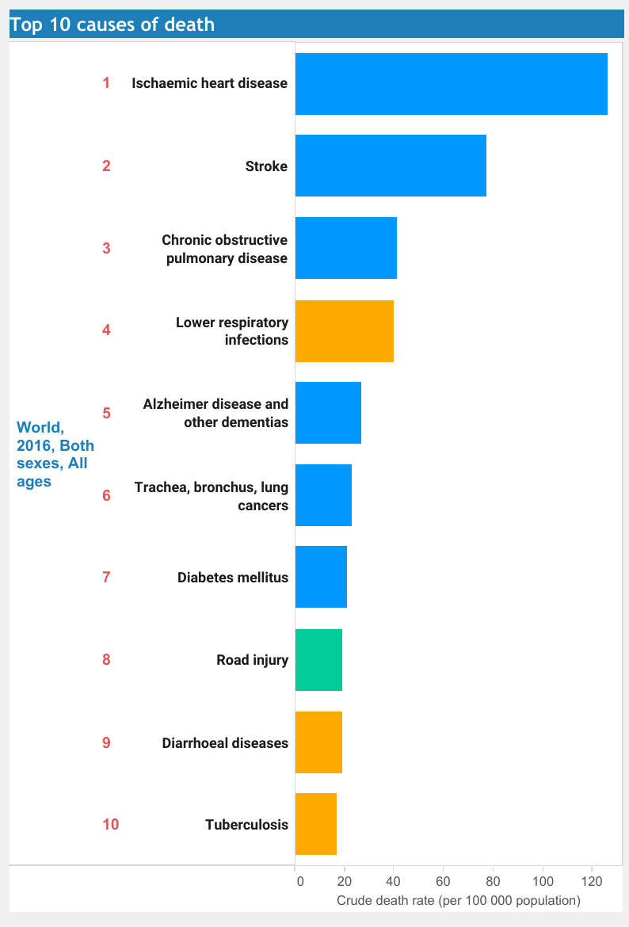
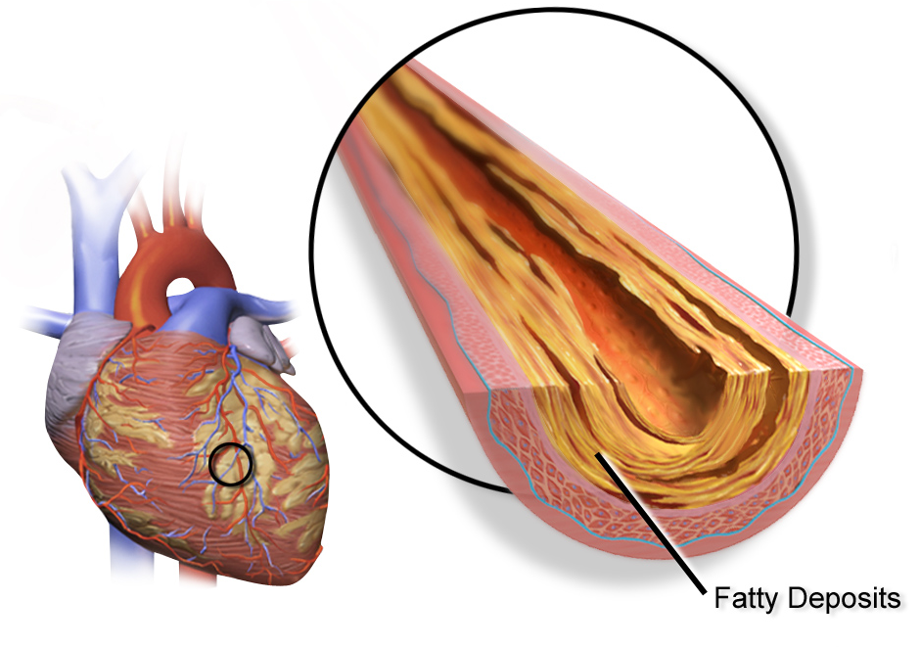
Significance of Research
Coronary Heart Disease: Inadequate supply of blood and oxygen to the heart due to the buildup of plaque in coronary arteries.
Source 1: Fatty Deposits in Coronary Arteries
Source 2: Top 10 Causes of Death Across the World in 2016

Slide 3
Purpose of Research
Develop 3 essential machine learning algorithms that would predict CHD with reliable accuracy
Determine the optimal number of attributes required to produce a comprehensive diagnosis
Determine the order of the most significant medical attributes and their impact on predicting heart disease

Slide 4
Optimal Number of Attributes
Number | Attributes
1 | Thalassemia
2 | Sex
3 | Number of Major Vessels colored by Fluoroscopy
4 | Chest Pain Type
5 | Exercise Induced Angina
6 | Resting Electrocardiographic Results
7 | Family History of CHD
8 | ST Depression induced by Exercise
9 | Maximum Heart Rate Achieved
10 | Slope of Peak Exercise ST Segment
11 | Resting Blood Pressure
12 | Smoker
13 | Duration of Exercise Test in Minutes
14 | METS Achieved
15 | Peak Exercise Blood Pressure
3
1
Top 5 Attributes
Top 10 Attributes
Top 15 Attributes
2
Feature sets mentioned above were selected using Relief-F algorithm
Features are ranked based on their distance from other instances
Top features are the most important predictors of CHD

Slide 5
Research Methodology & Machine Learning Models
Machine Learning is the ability of an algorithm or a classifier to find patterns in datasets, and to use those patterns to predict the results for new, unknown data.
Baseline Values for Classifiers
Data Preprocessing
Baseline Values for Classifiers
Feature Selection
Preliminary Results before Hyperparameter Optimization
Obtain Results on the Validation Set
Select Top 3 Classifiers from all Feature Sets
Final Results after Optimization
Hyperparameter
Optimization of the Selected Classifiers
Obtain Results on the Validation Set

Slide 6
Performance Measures of the Top Three Classifiers
No Heart Disease | Heart Disease | Classified as
16 | 2 | No Heart Disease
1 | 11 | Heart Disease
No Heart Disease | Heart Disease | Classified as
17 | 1 | No Heart Disease
3 | 9 | Heart Disease
No Heart Disease | Heart Disease | Classified as
15 | 3 | No Heart Disease
2 | 10 | Heart Disease
Confusion Matrix for
Naïve Bayes
Confusion Matrix for
Support Vector Machine
Confusion Matrix for
Logistic Regression

Slide 7
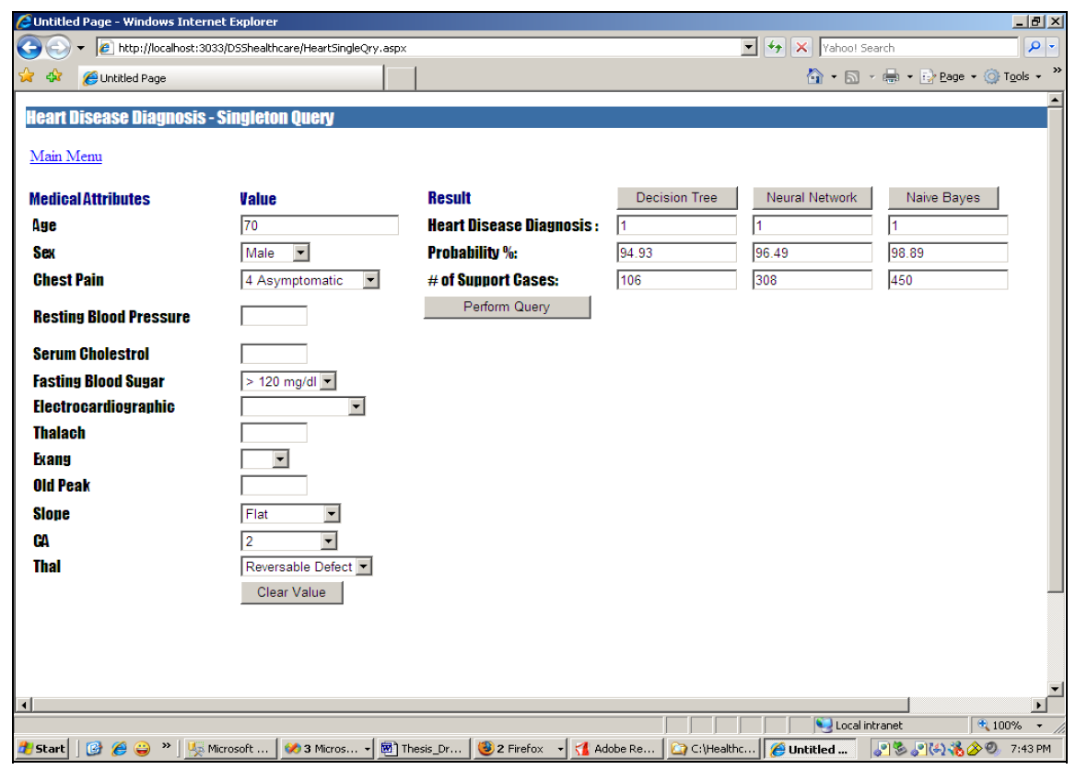
Next Steps
Test the models on larger and more recent datasets
Optimize the classifiers further by tuning more hyperparameters and by using ensemble techniques
Develop a HIPAA compliant app/website for diagnosticians to use to detect CHD
Intelligent Heart Disease Prediction System
S. Palaniappan and R. Awang, "Intelligent heart disease prediction system using data mining techniques," 2008 IEEE/ACS International Conference on Computer Systems and Applications, Doha, 2008, pp. 108-115.

Slide 8
Any Questions?

